Slide 1
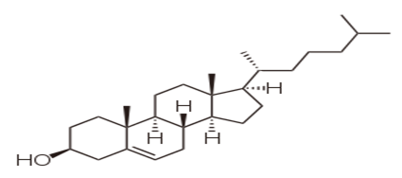
Cholesterol
is an organic molecule. It is a sterol (or modified steroid), a type of lipid. Cholesterol is biosynthesized by all animal cells ( composes about 30% of all animal cell membranes) and is an essential structural component of animal cell membranes.

Slide 2
Lipoproteins
A lipoprotein is a biochemical assembly whose primary purpose is to transport hydrophobic lipid (also known as fat) molecules in water, as in blood plasma or other extracellular fluids. They have a single-layer phospholipid and cholesterol outer shell, with the hydrophilic portions oriented outward toward the surrounding water and lipophilic portions of each molecule oriented inwards toward the lipids molecules within the particles. Thus, the complex serves to emulsify the fats in extracellular fluids. A special kind of proteins, called apolipoproteins, are embedded in the outer shell, both stabilising the complex and giving it a functional identity which determines its fate.
Many enzymes, transporters, structural proteins, antigens, adhesins, and toxins are lipoproteins. Examples include plasma lipoprotein particles (HDL, LDL, IDL, VLDL and chylomicrons), which enable fats to be carried in all extracellular water, including the blood stream. Subgroups of these plasma particles are primary drivers or modulators of atherosclerosis.

Slide 3
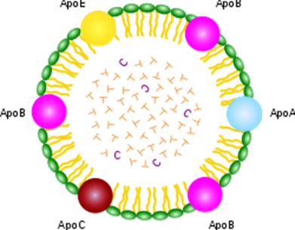

Slide 5
